Slide 1
Data Analysis of Pizza Ratings with R
Bin He

Slide 2
AGENDA
INFOGRAPHIC
Introduction
Packages Required
Data Preparation
Exploratory Data Analysis
Summary

Slide 3
Introduction
Machine Learning Data Analysis
To figure out the answers to these questions can help pizza restaurants improve the customers’ satisfaction in order to have more business.
Target 1
Target 2
Target 3
predict the review scores for individual pizza restaurants
find out the relationship between restaurant locations and price ranges
forecast the price levels of the restaurants

Slide 4
Nonlinear Multivariant Regression.
For review score prediction
The result of regression is the predicted value of review scores so that the restaurant can improve the service according to the critical predictors.
Main Algorithms
Random Forecast Classification
For price level prediction
The result of classification is the predicted group of price level the restaurant may belong to. It can help the restaurant re-adjust their prices.

Slide 5
R packages
library(readr)# used to load the datasets
library("corrplot")# used to visualize correlation matrix
library('MASS')# used for stepwise regression to remove variables
library('caret')# used for cross validation methods
library(dismo)# used to calculate the AUC values
library('sqldf')# used to adjust the dataset via SQL
library(caTools)# used to split the train-test dataset
library(e1071)# used for SVM algorithm
Packages Required

Slide 6
Data Preparation
Source Data and Code Book
1
Jared's dataset
from top NY pizza restaurants, with a 6 point likers scale survey on ratings
2
Barstool dataset
The Barstool Staff's rating as well as pricing, location, and geo-location. There are 22 pizza places that overlap between the two datasets. .
3
Pizza datafiniti
This includes 10000 pizza places, their price ranges and geo-locations.
4
Total information
There are 463 observations and 22 variables in Barstool, 10k observations and 10 variables in datafiniti, 375 observations and 9 variables in Jared’s..

Slide 7
Table Description
pizza_datafiniti
pizza_jared

Slide 8
Table Description
pizza_barstool
pizza_barstool

Slide 9
Preprocessing
Barstool data table
Missing Values:
longitude and latitude
average or total scores
Jared dataset
‘Excellent’, ‘Good’, ‘Average’, ‘Poor’ and ‘Never Again’
deleted the redundant columns
Pizza Datafiniti
remove the redundant data lines

Slide 10
Preliminary Finding
pizza1(barstool)
majority of restaurants are above average or people are likely to score higher according to a 0-10 scaling range
pizza2(datafiniti)
the average price range is between 4.67 to 27.8, slightly higher than normal level 0 to 25
pizza3(jared)
about 14 customers would like to evaluate the service for each restaurant online for others’ reference.

Slide 11
Exploratory Data Analysis and Visualization

Slide 12
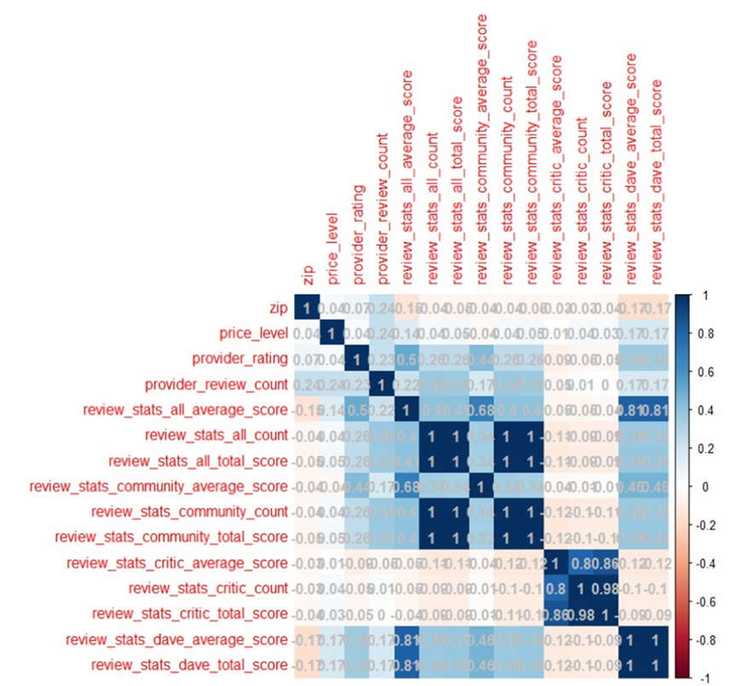
Pizza1(barstool)
Process
zip code and latitude/longitude can be removed
split the dataset into train/test groups by 0.55/0.45
correlation matrix is employed
the darker color refers to the higher correlation between any two attributes
an approach named stepwise regression can also be used to remove more attributes.
only zip, price_level, provider_rating and review_stats_all_total_average as X which affect Y review_stats_all_average_score

Slide 13
Methodology
Nonlinear multivariant regression model
it is a regression problem that we need to predict the scores based on all the input Xs.
K fold cross validation method
we just have 254 observations which are too few to fit an accurate model. Need to increase the samples

Slide 14
71%
Normal linear regression model
Option1
Area Under Curve represents the areas under ROC receiver Operating Characteristic Curve. The higher the better.
67%
Linear model with k fold method
Option2
AUC accuracy is as low as 67% which is even worse. So this method needs to be abandoned
76%
Nonlinear multivariant regression
Option3
This model shows that the multiple independent variables might have nonlinear relationships with y, rather than a linear relationship.

Slide 15
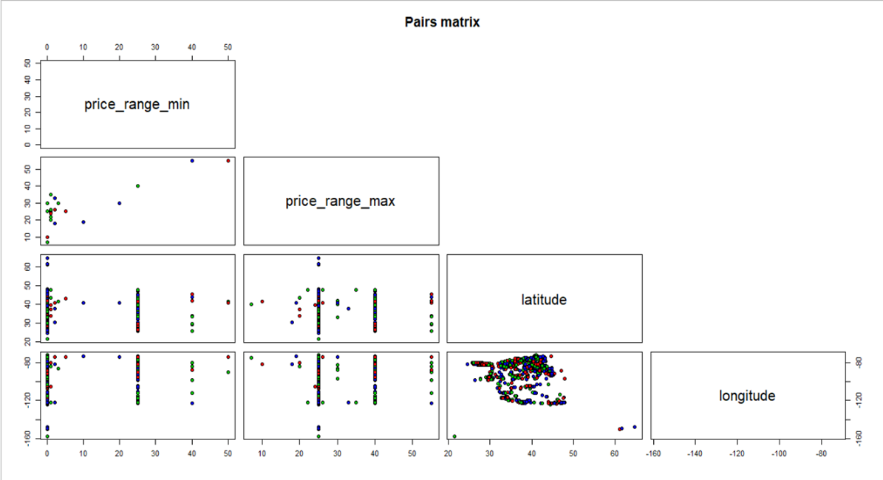
Pizza2(datafiniti)
Process
to find out if there is any relationship between restaurant position and its price range. split the dataset into train/test groups by 0.55/0.45
null Hypothesis H0: No relationship between geography variables and Price Range variables
alternate Hypothesis HA: There exists a relationship between geography variables and Price Range variables.
p value is smaller than 2.2e-16
null hypothesis is wrong and alternative hypothesis should be adopted.
The results are train RMSE = 0.828965 and test RMSE = 0.7605214

Slide 16
Pizza3(jared)
Merged this dataset with the other two
calculated one weighted average value for ‘answer’ instead of using 5 different values for each restaurant.
the 5 categories respectively represent the scores from 4 to 0
5 scores times their respective numbers of voters and each total is divided by each voter number. The result is the weighted average score.
85.7%
SVM
89.5%
PRF
After splitting the train/test and scaling the dataset, I used two classification methods to test the accuracy of classifier. Due to their better performance, I used Support Vector Machine and Parallel Random Forecast to train and test the model.

Slide 17
Summary
Summary
uncovered some insights about the rating for pizza restaurant with three different datasets.
01
Methodology
nonlinear multivariant regression model to find out the relationship and the fitted model to make the prediction for the review scores.
02
Limitation
pool of sample records is too small to have an accurate result.
majority of the records in each table is not relative to each other.
03

Slide 18
SPECIAL FOOD
Thank you
All

